Slide 1
DNA REPLICATION
GROUP 1

Slide 2
CHAPTER OUTLINE
1
2
BACTERIAL DNA REPLICATION
STRUCTURAL OVERVIEW OF DNA REPLICATION
3
EUKARYOTIC DNA REPLICATION

Slide 3
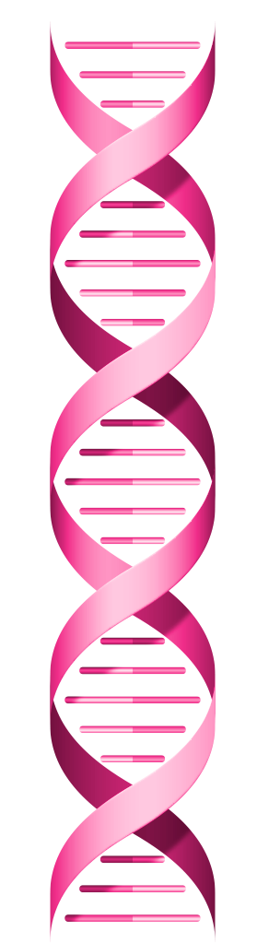
WHAT IS DNA REPLICATION ?
DNA replication is the process by which DNA makes a copy of itself. This happens during cell division, making sure that each new cell receives the same genetic information as the parent cell.

Slide 4
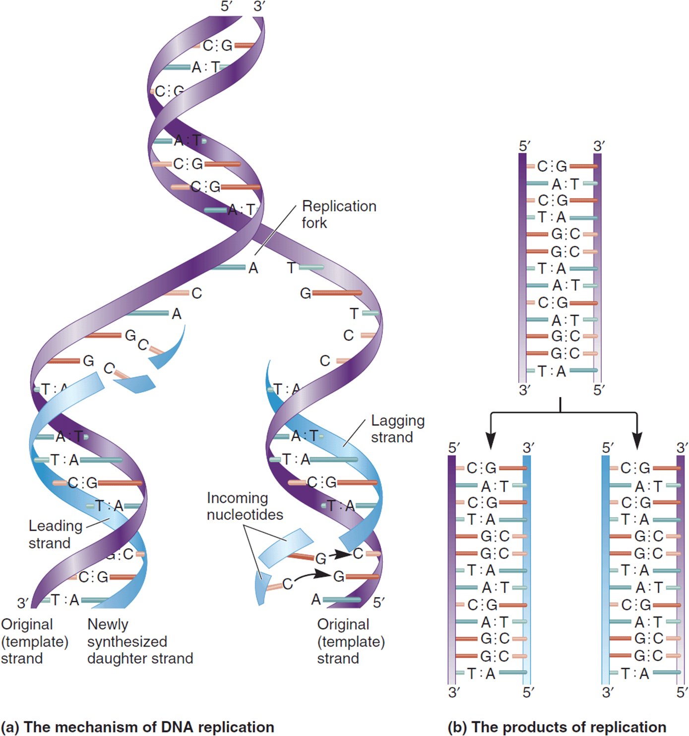
STRUCTURAL OVERVIEW OF DNA REPLICATION
The double helix is composed of two DNA strands, and the individual building blocks of each strand are nucleotides. The nucleotides contain one of four bases: adenine, thymine, guanine, or cytosine.
The AT/GC rule or Chargaff's rule, is the basis for the complementarity of the base sequences in double-stranded DNA.
The strands within a double helix have an anti-parallel alignment.

Slide 5
Existing DNA Strands Act as Templates for the Synthesis of New Strands
During the replication process, the two complementary strands of DNA come apart and serve as template strands for the synthesis of two new strands of DNA.
The two newly made strands are referred to as the daughter strands, while the original strands are called the template strands or parental strands.

Slide 6
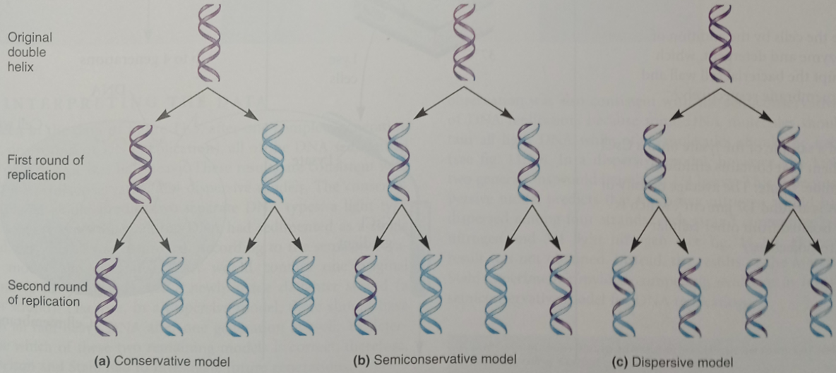
Existing DNA Strands Act as Templates for the Synthesis of New Strands
CONSERVATIVE MODEL
Both strands of parental DNA remain together following DNA replication. In this model, the original arrangement of parental strands is completely conserved, while the two newly made daughter strands are also together following replication.

Slide 7
Existing DNA Strands Act as Templates for the Synthesis of New Strands
SEMICONSERVATIVE MODEL
The double-stranded DNA is half conserved following the replication process. In other words, the double-stranded DNA contains one parental strand and one daughter strand.

Slide 8
Existing DNA Strands Act as Templates for the Synthesis of New Strands
DISPERSIVE MODEL
Proposes that segments of parental DNA and newly made DNA are interspersed in both strands following the replication process.

Slide 9
BACTERIAL DNA REPLICATION

Slide 10
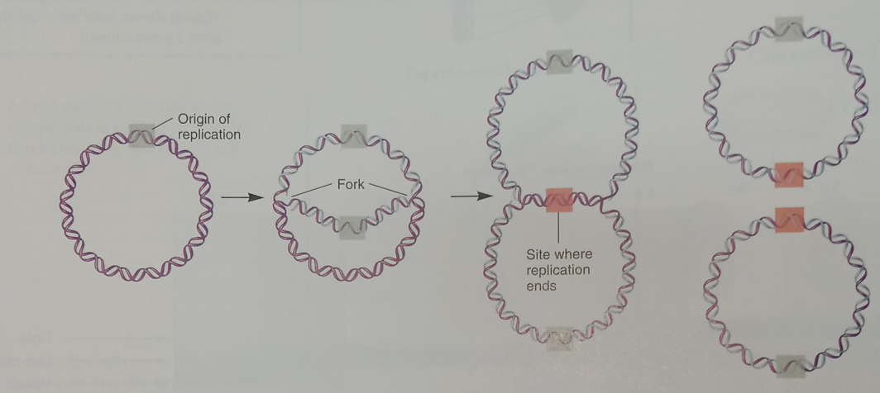
Bacterial Chromosomes Contain a
Single Origin of Replication
The site on the bacterial chromosome where DNA synthesis begins is known as the origin of replication. The synthesis of new daughter strands is initiated within the origin and proceeds bidirectionally (in both directions) around the bacterial chromosome.

Slide 11
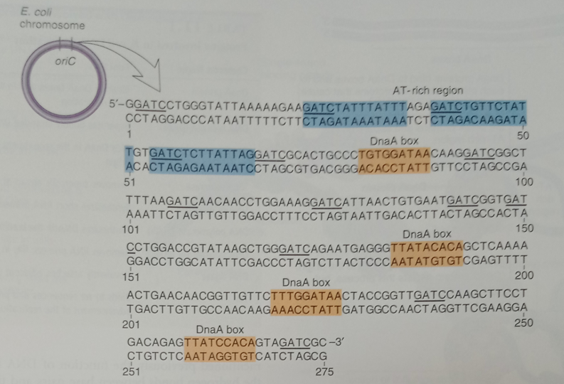
Replication Is Initiated by the Binding
of DnaA Protein to the Origin of Replication
The origin is named oriC (for origin of Chromosomal Replication).
There are three types of DNA sequences within oriC that are functionally important:
an AT-rich region,
DnaA box sequences, and
GATC methylation sites.

Slide 12
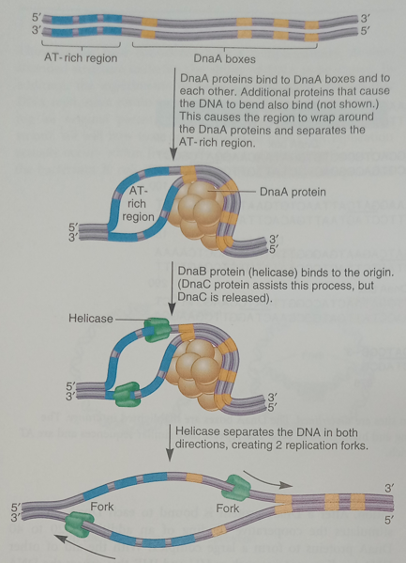
DnaA proteins bind to the four DnaA boxes in oriC to initiate DNA replication.
With the aid of other DNA-binding proteins such as HU and IHF, this causes the DNA to bend around the complex of DnaA proteins and results in the separation of the AT-rich region.
The DnaA proteins, with the help of the DnaC protein, recruit DNA helicase enzymes (also known as DnaB helicase, or simply as helicase) to bind to this site.
The action of DNA helicases promotes the movement of two forks outward from oriC in opposite directions.
This initiates the replication of the bacterial chromosome in both directions, an event termed bidirectional replication.

Slide 13
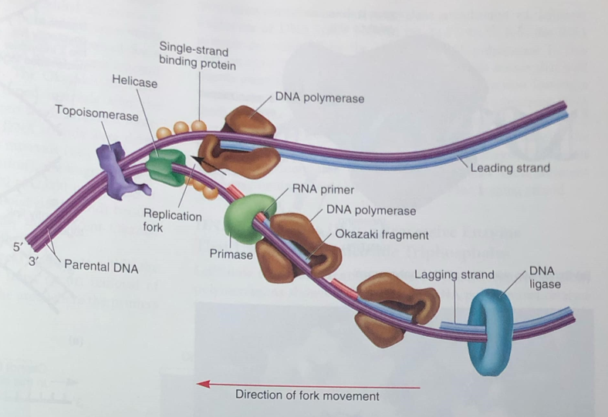
DNA Strand Separation and the Synthesis RNA Primers Are Necessary Before Daughter Strands
of DNA Can Be Made
An enzyme, known as DNA gyrase (a topoisomerase type ll enzyme) travels ahead of the helicase enzyme and alleviates this supercoiling.
The single-strand binding protein is to bind to both of single strands of parental DNA and prevent them from re-forming a double helix.

Slide 14
DNA Strand Separation and the Synthesis RNA Primers Are Necessary Before Daughter Strands
of DNA Can Be Made
The next event involves the synthesis of a short strand of RNA (rather than DNA) called an RNA primer.
This strand of RNA is synthesized by the linkage of ribonucleotides via an enzyme known as DNA primase or simply primase.
This enzyme synthesizes short strands of RNA, typically 10 to 12 nucleotides in length.

Slide 15
DNA Polymerases Link Nucleotides to Synthesize the Daughter Strands
The enzymes known as DNA polymerases are responsible for covalently attaching nucleotides together to make new daughter strands.
In E. coli, there are five distinct proteins that function as DNA polymerases, designated pol l, Il, Ill, IV, and V.
Pol l and pol lll are involved in normal DNA replication
Pol ll, pol lV and pol V play a role in DNA repair and the replication of damaged DNA.

Slide 16
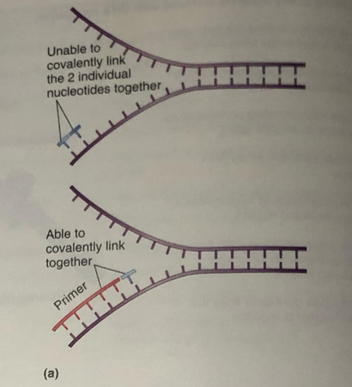
DNA Polymerases Link Nucleotides to
Synthesize the Daughter Strands
The DNA polymerase cannot begin DNA synthesis by linking together two individual nucleotides. Rather, this enzyme can only elongate a strand starting with an RNA primer or existing DNA strand.

Slide 17
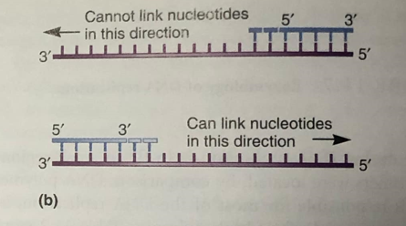
DNA Polymerases Link Nucleotides to
Synthesize the Daughter Strands
A second unusual feature is the directionality of strand synthesis. DNA polymerases can attach nucleotides only in the 5' to 3' direction, not in the 3' to 5' direction.

Slide 18
DNA Polymerases Link Nucleotides to Synthesize the Daughter Strands
The two new DNA strands (namely, the leading and lagging strands) are synthesized in different ways.
In Leading Strand, synthesis of the daughter strand is continuous.
In Lagging Strand, synthesis of DNA occurs in short Okazaki Fragments.
An enzyme known as DNA ligase catalyzes a covalent bond between these adjacent DNA fragments to complete the process in the lagging strand.

Slide 19
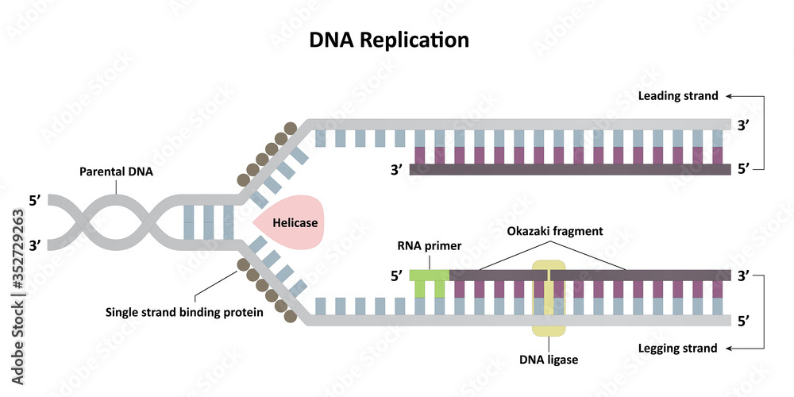
Okazaki Fragments named after Reiji and Tuneko Okazaki, who initially discovered them in the late 1960s.

Slide 20
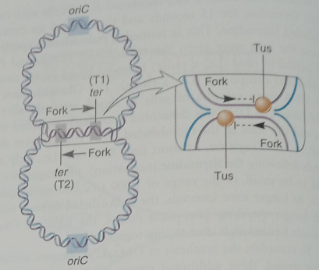
Replication Is Terminated When the Replication
Forks Meet at the Terminus Sequences
On the opposite side of the E. coli chromosome from oriC is a pair of termination sequences called ter sequences.
A protein known as the termination utilization substance (Tus) binds to the ter sequences and stops the movement of the replication forks.
DNA replication ends when oppositely advancing forks meet, usually at T1 or at T2.

Slide 21
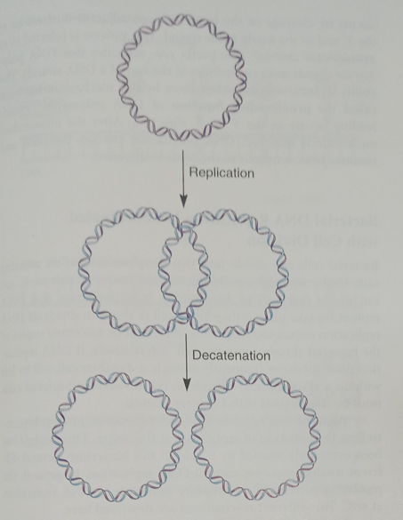
Replication Is Terminated When the Replication
Forks Meet at the Terminus Sequences
Interlocked circular molecules are known as catenanes. Topoisomerases introduce a temporary break into the DNA strands and then rejoin them after the strands have become unlocked. This allows the catenanes to be separated individual circular molecules.

Slide 22
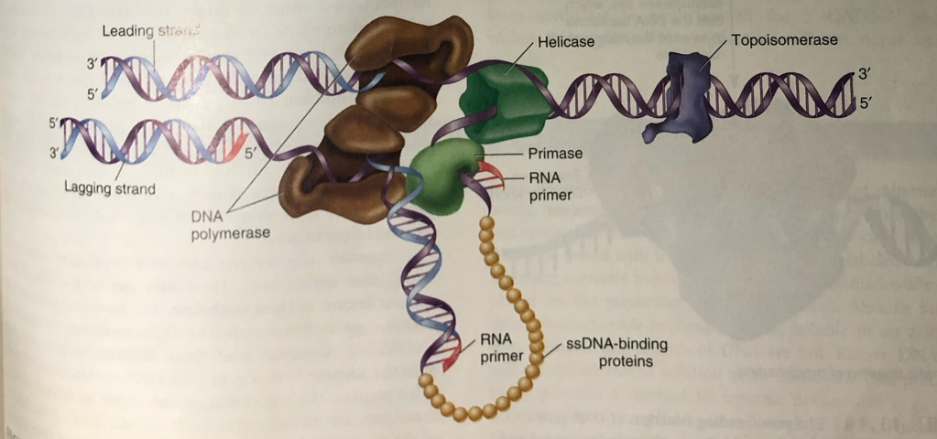
Certain Enzymes of DNA Replication Bind to Each Other to Form a Complex
The replication of double-stranded involves an assembly of proteins called the replisome.
DNA helicase and primase are physically bound to each other to form a complex known as a primosome.

Slide 23
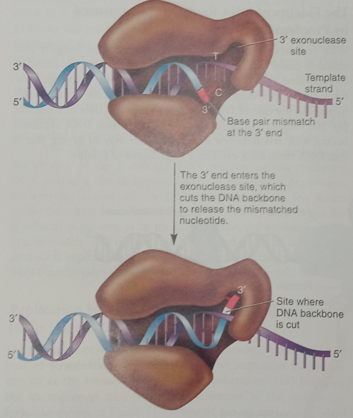
The Fidelity of DNA Replication is Ensured by Proofreading Mechanisms
The DNA replication exhibits a high degree of fidelity.
The hydrogen bonding between G and C or A and T is much mores stable than between mismatched pairs.
Proofreading function the ability to remove mismatched bases.

Slide 24
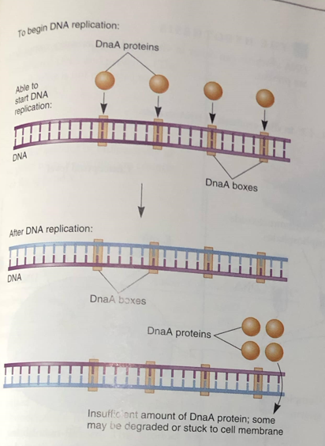
Bacterial DNA Replication is Coordinated with Cell Division
E. coli can divide every 20 to 30 minutes.
DNA replication take place only when a cell is about to divide.
The DnaA protein binds to DnaA boxes within the origin of replication and opens the DNA helix at the AT -rich region within the origin.
Immediately following DNA replication, there are twice as many DnaA boxes, and so there is insufficient DnaA protein to initiate a second round of replication.
Since it takes time to accumulate newly made DnaA protein, DNA replication cannot occur until the daughter cells have had time to grow.

Slide 25
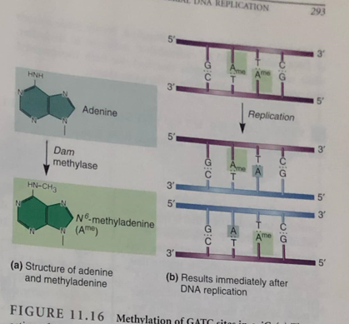
Bacterial DNA Replication is Coordinated with Cell Division
Another way to regulate DNA replication involves GATC sites within oriC. These sites can be methylated by enzyme known as Dam methylase (DNA adenine methyltransferase).
The Dam methylase recognize 5'—GATC—3' sequence, binds there, and attaches a methyl onto the adenine base (fig.11.16a).
Prior to DNA replication these sites are methylated in both strands. This full methylation of the 5'—GATC—3' sites facilitates the initiation of DNA replication at the origin. Following DNA replication, the newly made strands are not methylated, since adenine rather than methyladenine is found in the daughter strands (fig.11.16b).

Slide 26
EUKARYOTIC DNA REPLICATION

Slide 27
THANK YOU !!

